Slide 1
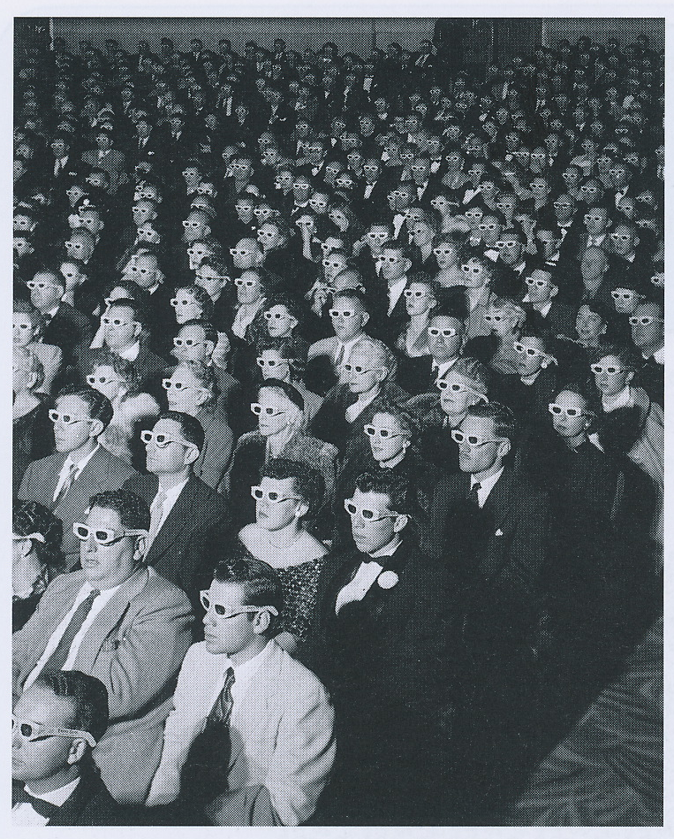
3-D Vision
David Meredith
Aalborg University

Slide 2
Source
This lecture is based on Chapter 7 of
Snowden, R., Thompson, P. & Troscianko, T. (2006). Basic Vision: An Introduction to Visual Perception. OUP. (ISBN: 978-0199286706)

Slide 3
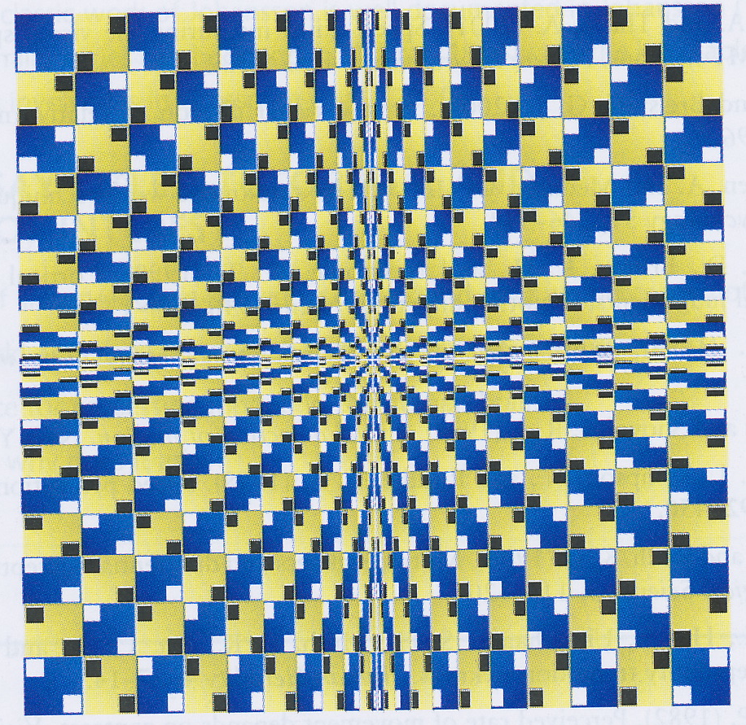
“Valley” by Akiyoshi Kitaoka
Centre of figure seems to be disappearing into the distance
Use changing sizes of the square elements to perceive depth
Perceive changes in shape of the elements as being due to perspective
Prefer to see all elements as being the same shape seen from different angles and at different distances
All lines are actually straight!

Slide 4
Overview
Need to be able to judge distances so that we can
pick up our beer glass
drive our car down a winding road
throw a ball to someone
Visual system must infer depth (i.e., third dimension) from a two-dimensional projection on the retina
We use various cues to help
differences between images in two eyes
patterns of shadows
occlusion

Slide 5
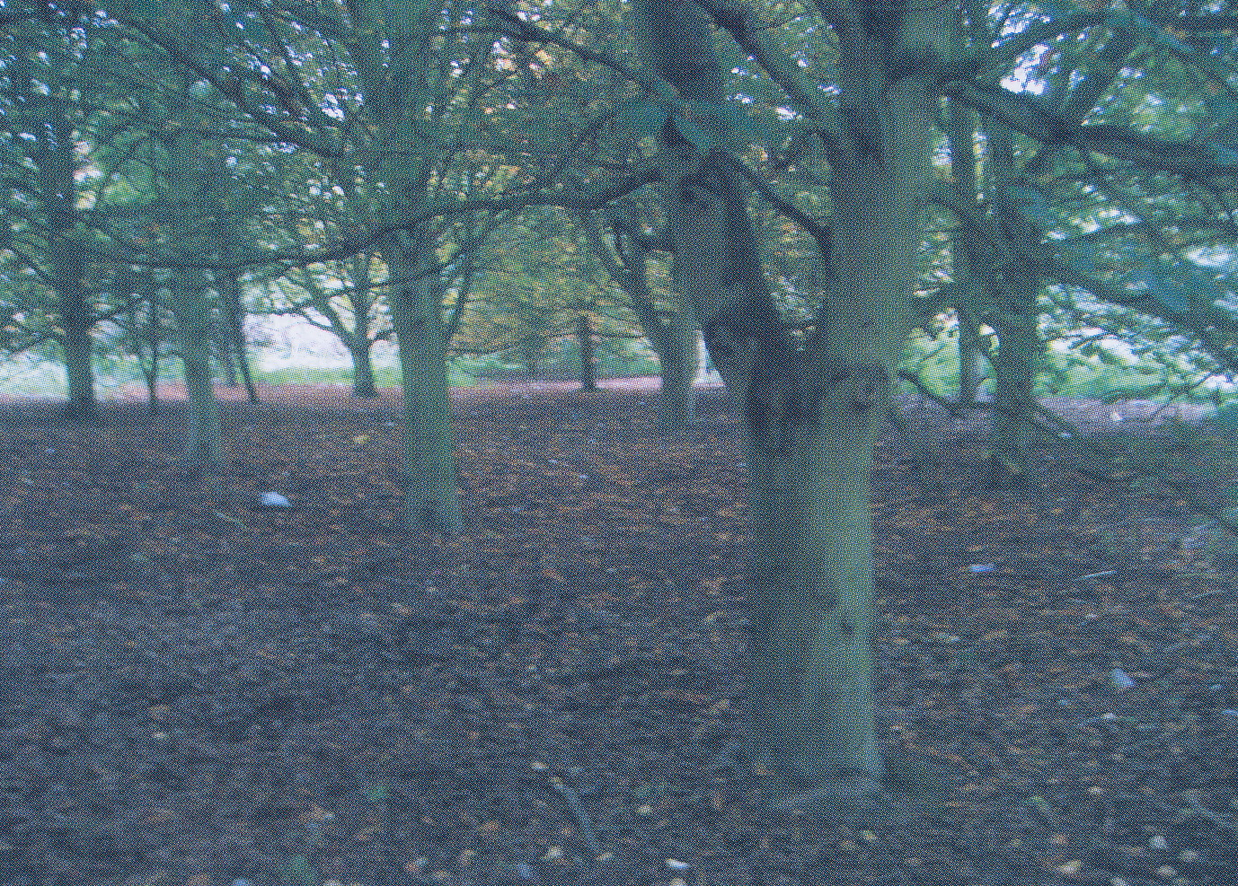
Walking through a forest
We can tell how big each tree is and how far away it is
Information not directly available in retinal image
just tells us the direction of the tree
We use cues such as stereopsis and occlusion

Slide 6
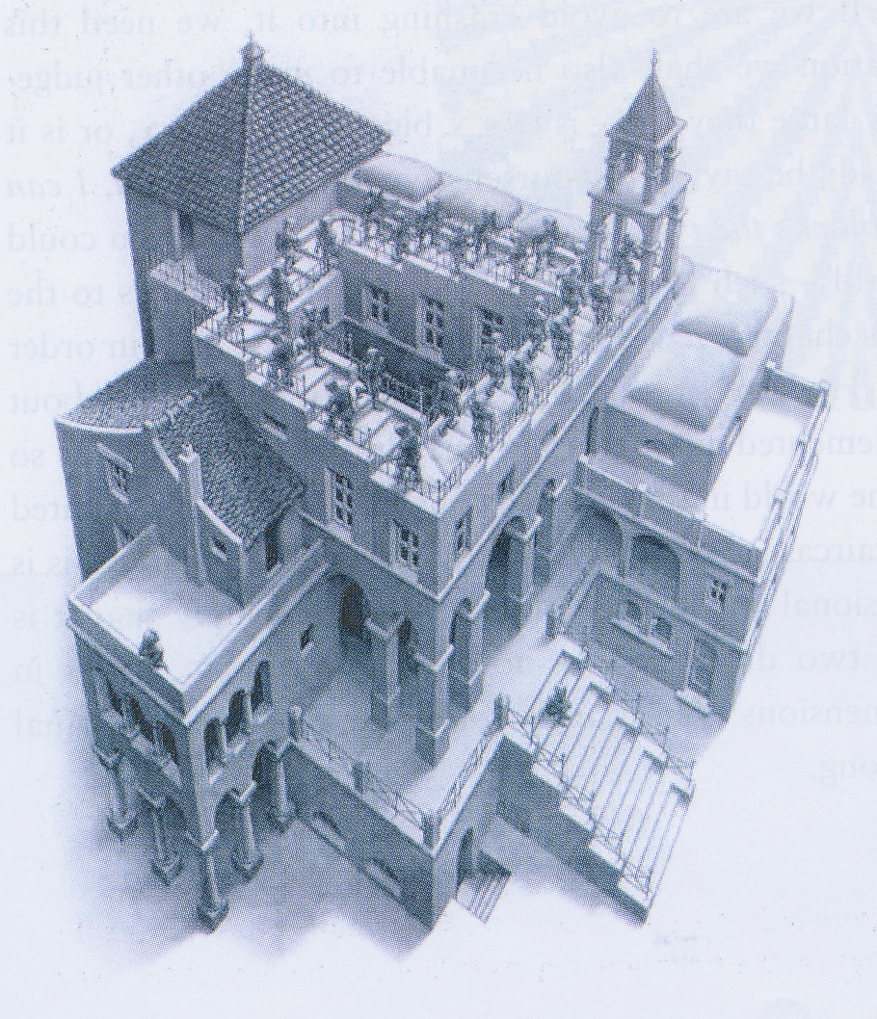
3-D vision is involuntary and unconscious
Inference of depth done early and unconsciously in visual system
Have no choice but to see images as being representations of three-dimensional scenes
Even if we know the perceptual solution that arises is impossible!

Slide 7
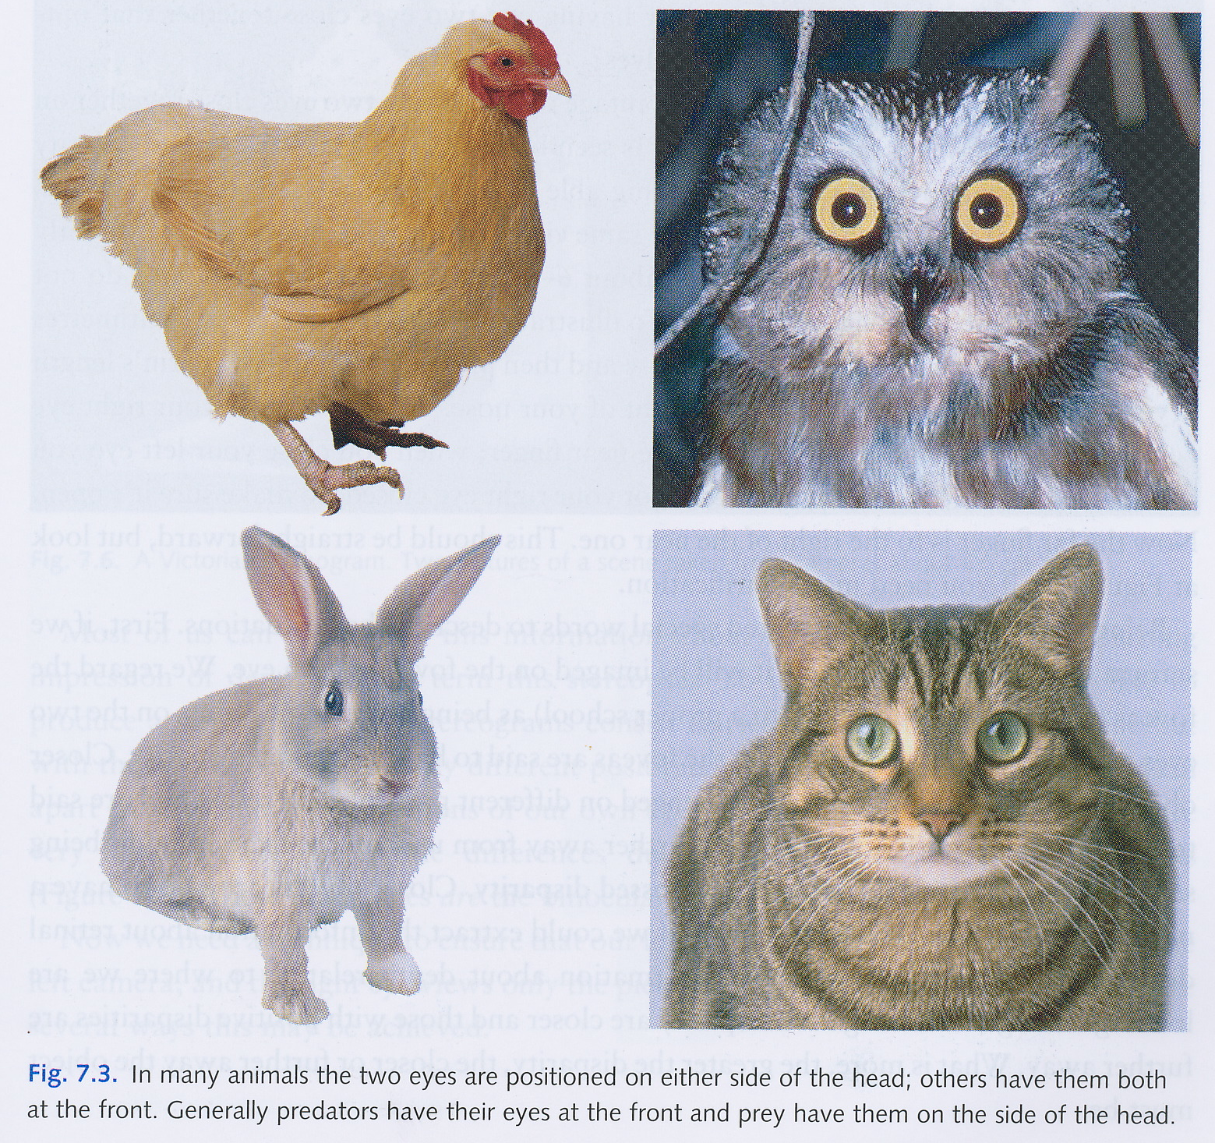
Animals generally have two eyes
Most animals have two eyes (not one or three) and they are positioned in roughly the same places
A herbivore generally has an eye on each side of its head so that it can get the widest possible field of view
Predators usually have two eyes looking forward on either side of their noses

Slide 8
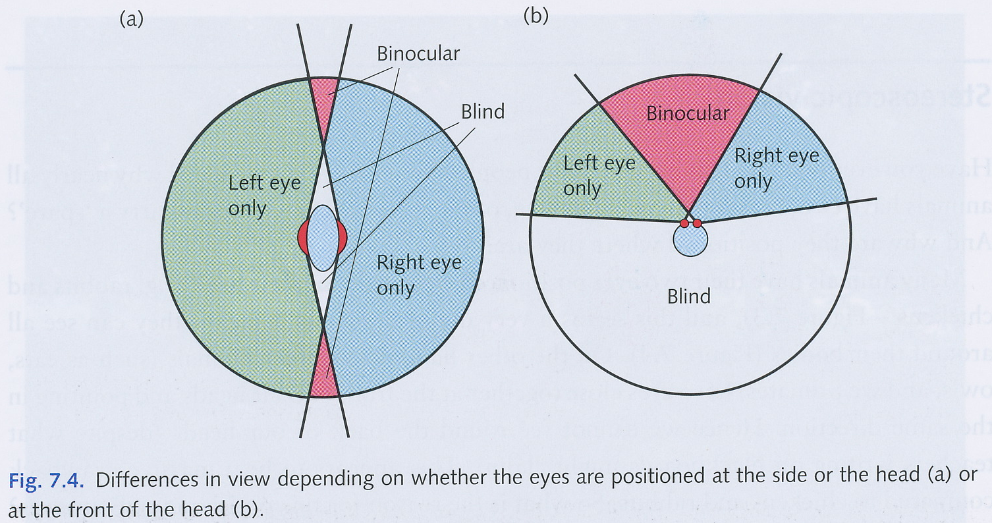
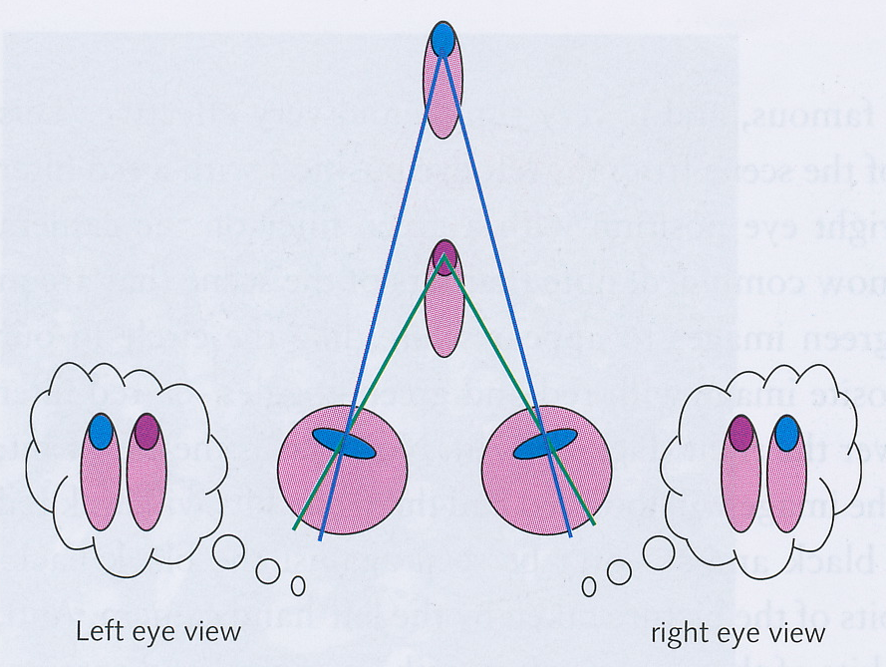
Binocularity
Having two eyes close together facing forward gives a wider field of view that is seen by both eyes – a larger area of binocularity
Each eye gets a slightly different retinal image
Hold two fingers up at different distances,
shut left eye, far finger is to the right of the near finger
shut right eye, distant finger is to the left of the near finger

Slide 9
Retinal disparity
If images of both eyes on foveae, then no retinal disparity
Closer objects imaged at different locations on the retina than distant objects, gives rise to retinal disparity
Objects further away than the fixation point have positive disparity or uncrossed disparity
Closer objects have negative disparity or crossed disparity
Retinal disparity gives us important information about depth

Slide 10
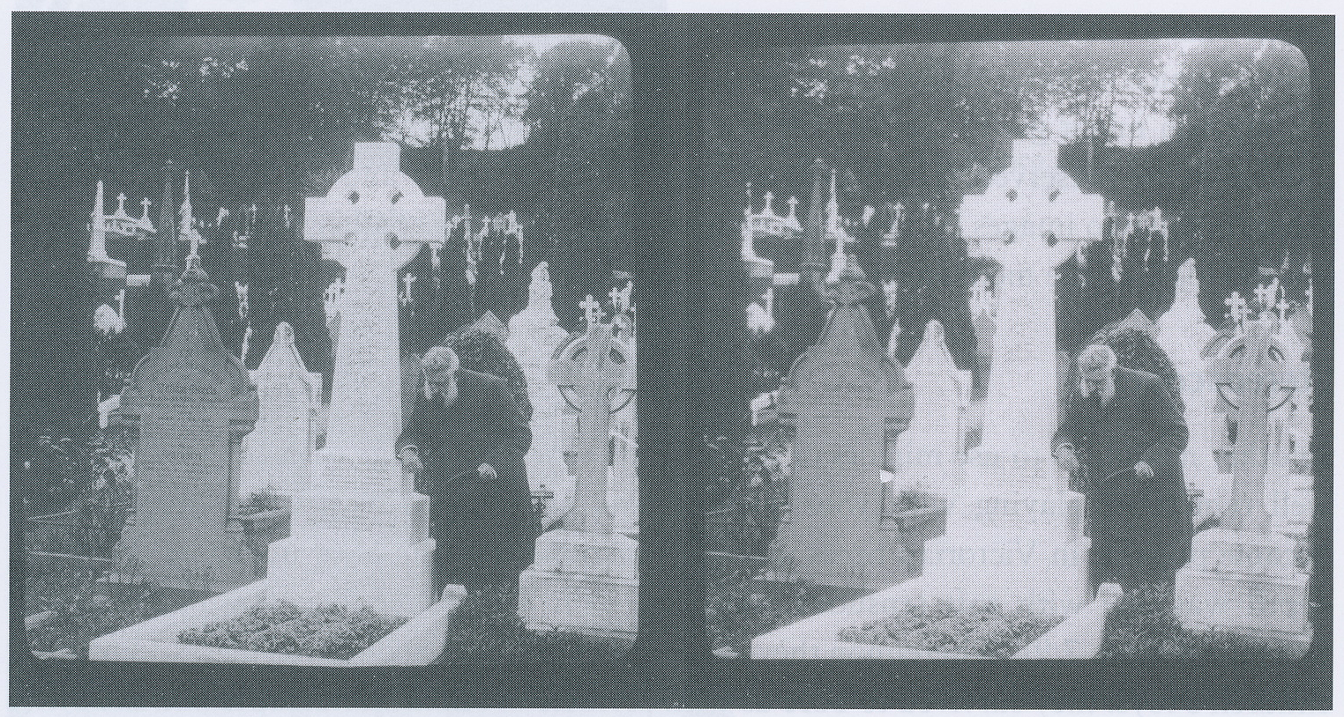
Stereopsis
Retinal disparity can be used to get a strong impression of depth – this is called stereopsis
Stereograms take advantage of this
two pictures of the same scene taken with cameras typically 6.5 cm apart
differences between the images is the binocular disparity
Need technique to make sure that left eye sees one picture and right eye sees the other
Several ways of doing this...

Slide 11
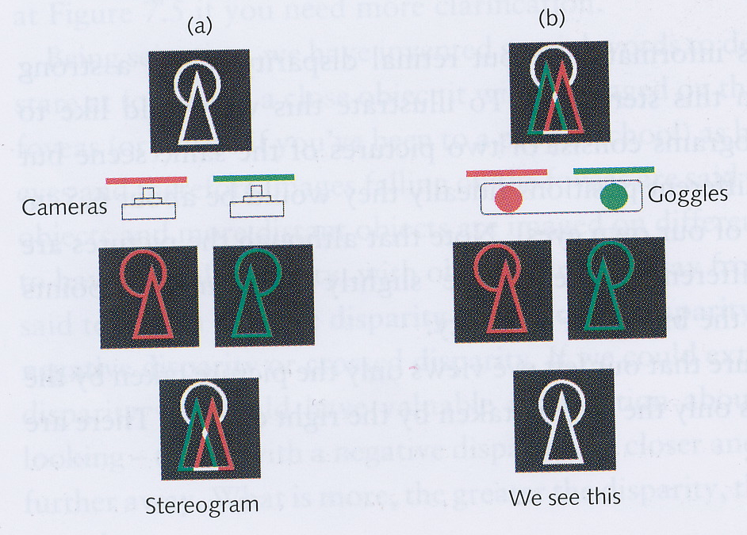
Red/green anaglyphs
Take picture of scene from left eye position with a red filter and one from the right eye position with a green filter
Pictures combined so that bits visible from both eyes are white
View composite image with red/green goggles
Red filter over left eye, green filter of right eye
Through red filter can see red parts and white parts but not green parts
Left eye only sees parts of picture taken by left-eye camera and right eye only sees parts taken by right-eye camera
Brain reconstructs 3-D scene from the two disparate images

Slide 12
3-D films and IMAX
Popular with movie-makers in the 1950s
But messes up colour in the movie
IMAX cinemas use two images that differ in terms of polarization instead of colour

Slide 13
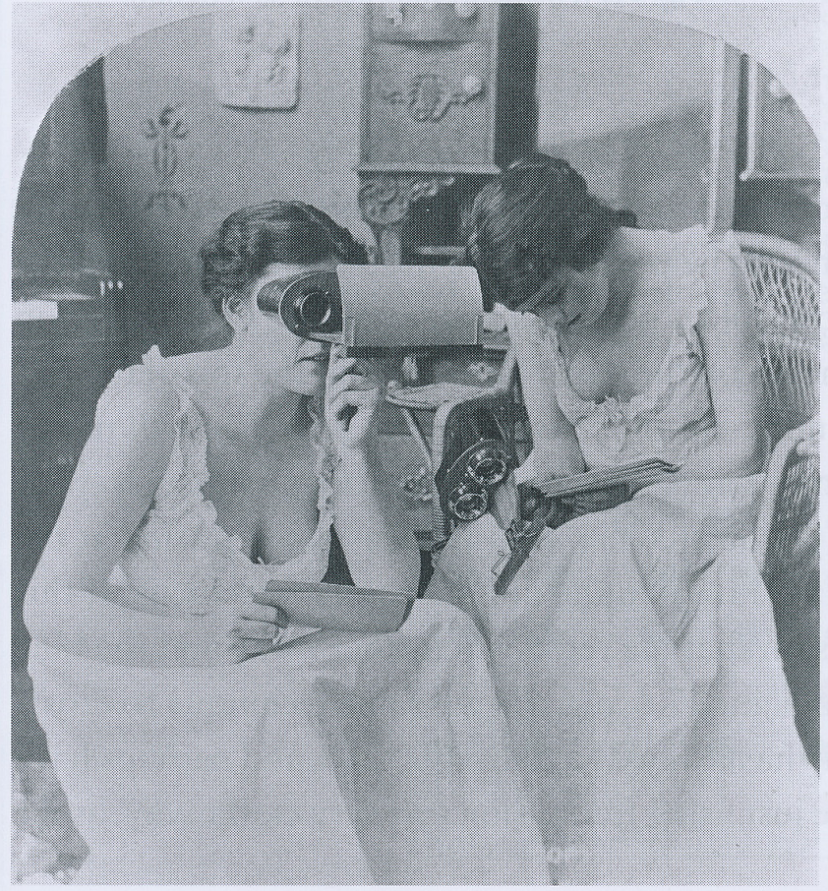
Stereoscopes
View-Master stereoscopes used lenses and mirrors to present each image to the eyes
Popular since Victorian times
particularly with certain types of images...
Later became sold to tourists and as children’s toys
Virtual reality headsets typically present left channel on odd-numbered frames and right channel on even-numbered frames
Shutters close over each eye alternatively at a very high rate

Slide 14
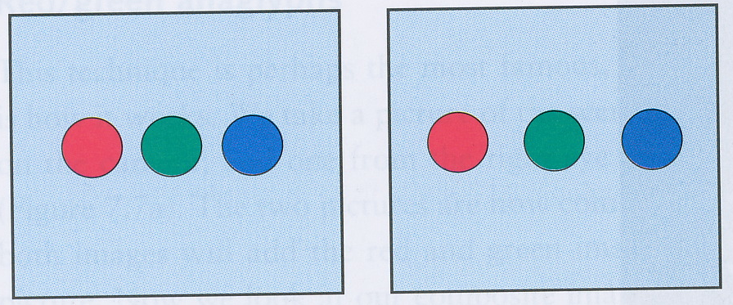
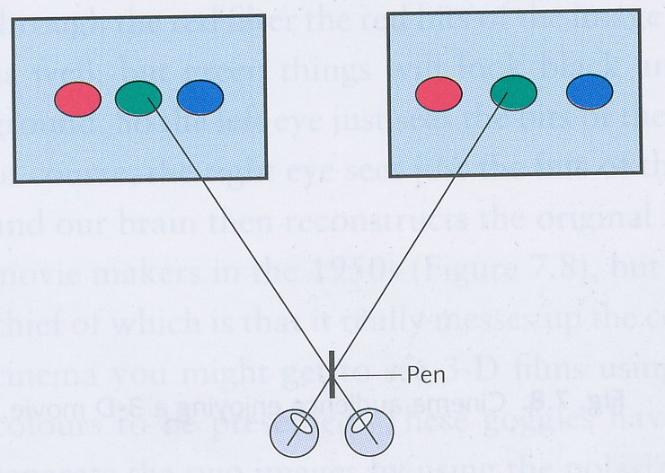
Free fusion
Also called cross-fusion
Cross eyes so that point of focus is in front of the page
See a third image appear in between the other two
This middle image has depth
Brain uses retinal disparity to fuse two different images into a single image with depth

Slide 15
Autostereograms (“Magic Eye” pictures)
http://www.rhythm.com/~keith/autoStereoGrams/vortexas2.gif

Slide 16
Autostereograms (“Magic eye” pictures)
http://www.rhythm.com/~keith/autoStereoGrams/horseas.gif

Slide 17
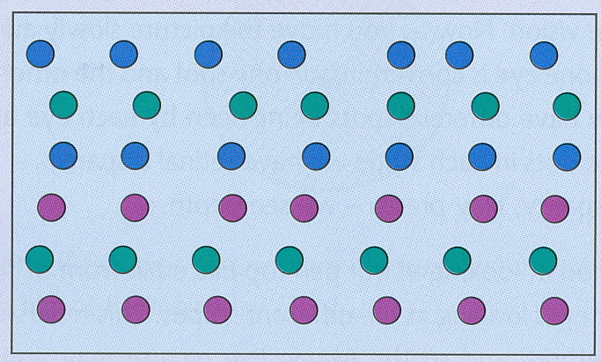
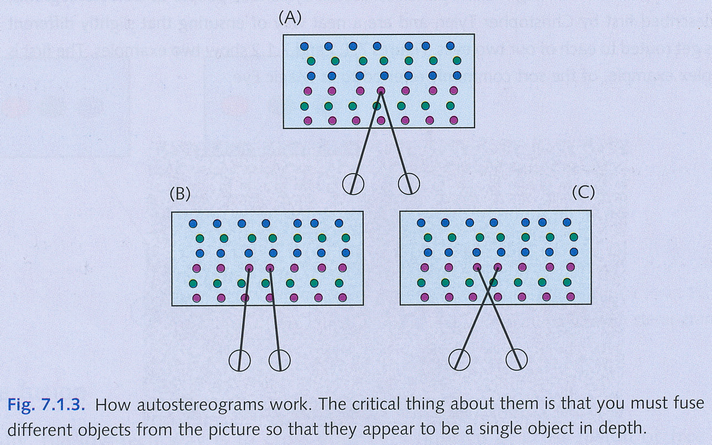
Autostereograms
First described by Christopher Tyler (1979)
Pattern repeats itself in a series of stripes, but stripes do not repeat perfectly
Usually image on each fovea is the same, leading to no disparity (and no depth in an autostereogram image)
Need to get one stripe on one fovea and the adjacent stripe on the other fovea
Now we have disparity, and therefore depth
Can do this by crossing eyes or focusing “behind” the plane of the image (can also use a pen top, or start very close and move away, etc.)

Slide 18
The correspondence problem
In stereopsis, brain must identify corresponding parts of the two images from the eyes – how does it do this?
This is the correspondence problem
Sometimes there are many ways of getting a good match between the two images
stare at gravel
several ways of seeing the same autostereogram

Slide 19
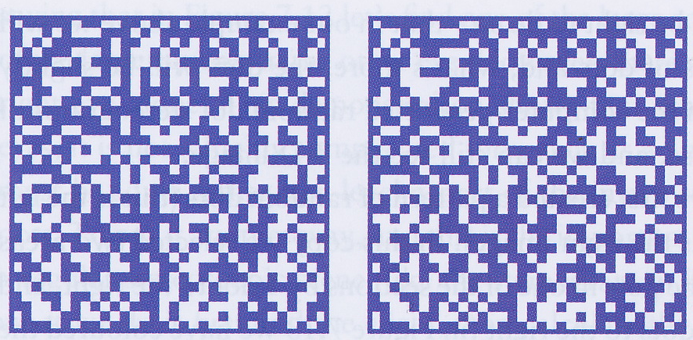
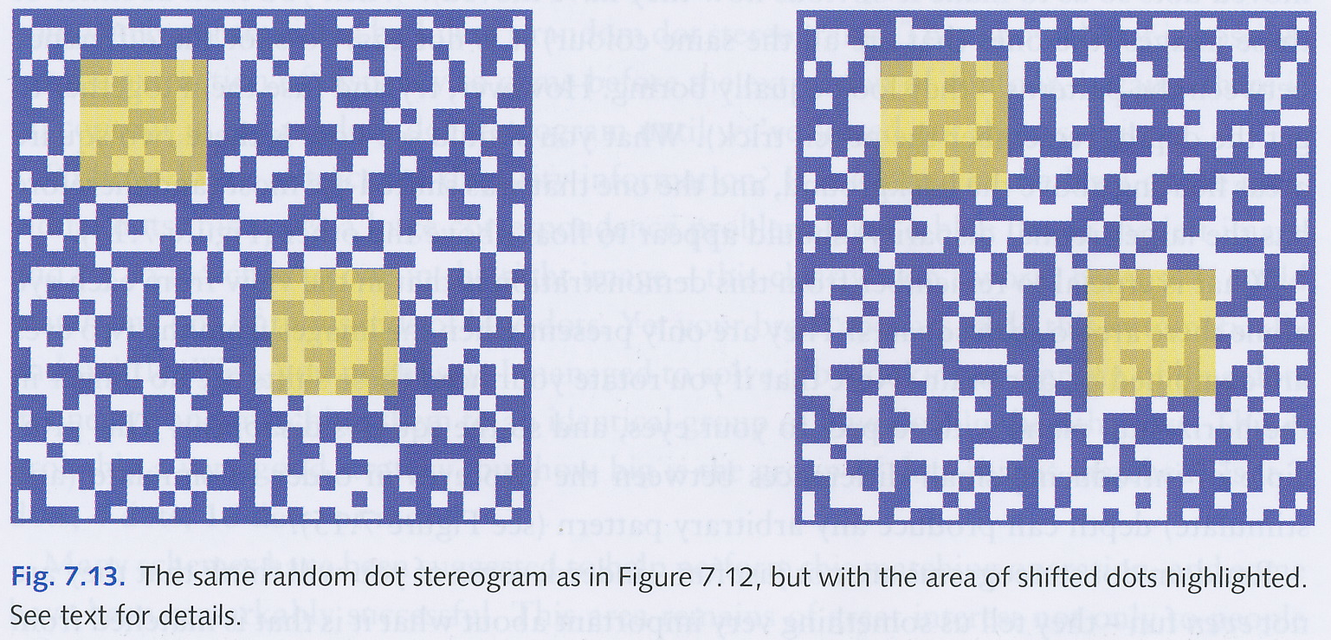
Random dot stereograms
Invented by Bela Julesz in the 1960s
Stereogram in two halves
Left and right halves are the same except for small patches that have been shifted by 1 or two dots
Gaps filled with new random dots
Shifted patches have different retinal disparity and the brain interprets as being due to different depth
But remember that the eyes simply send two images to the brain that compares these and infers a 3-D image

Slide 20
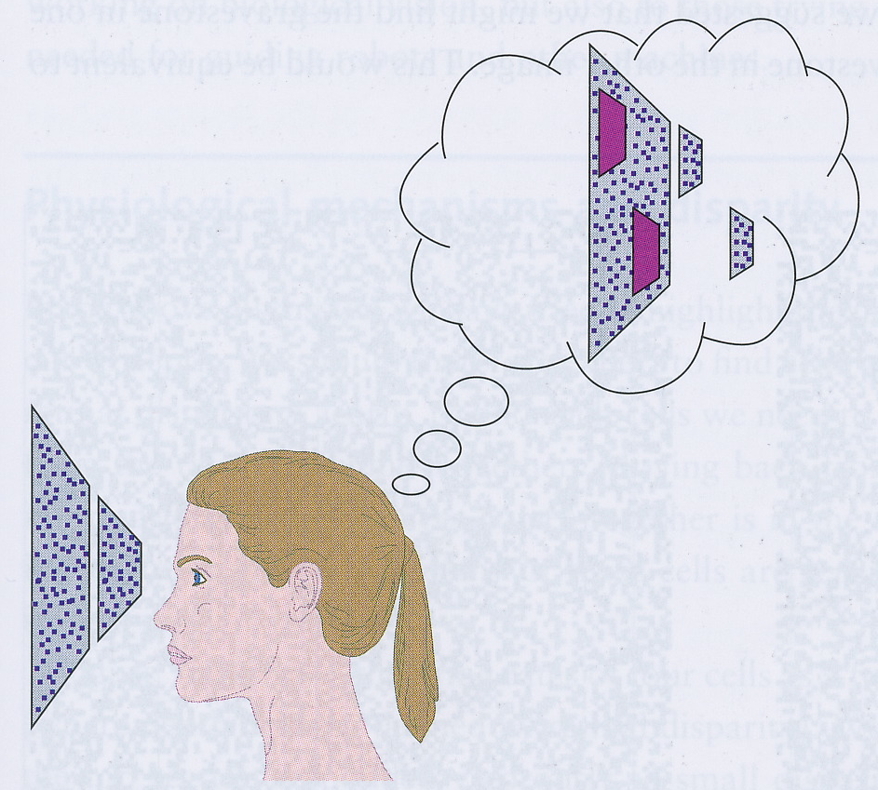
Random dot stereograms
See contour of disparate shapes only after the disparity has been used to compute the 3-D scene
So brain is not using edges to determine 3-D scene
Interesting algorithmic problem: finding the best matches between two similar images
Clearly brain assumes that the two images are almost similar, so only looks for very small differences between nearby regions of the space

Slide 21
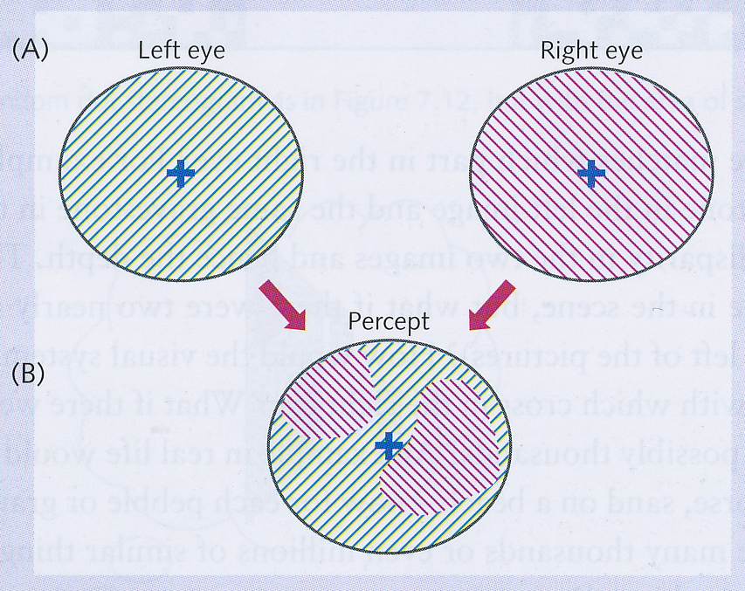
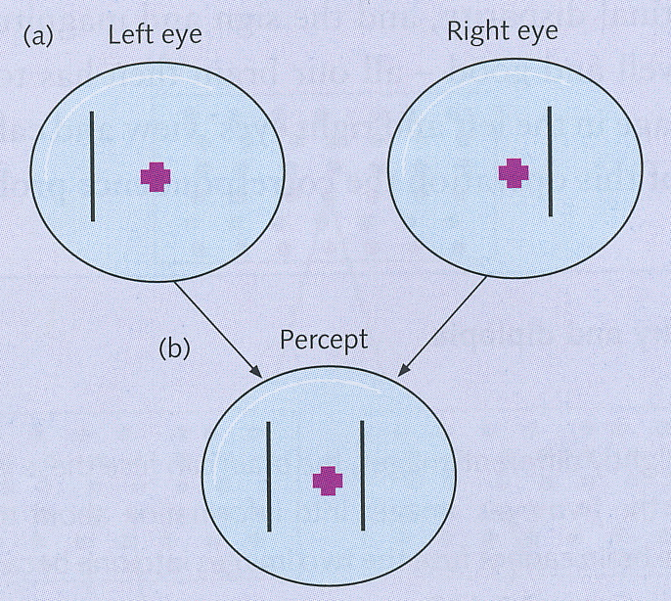
Binocular rivalry and diplopia
If images from eyes are very similar, then brain fuses them into one and uses disparity to compute depth
If images are too different, then it cannot do this – binocular rivalry
See some parts of one image and other parts of the other image
Parts seen change over time
One image may dominate the other if it has many contours, especially moving contours
Also, if one eye is very much more dominant than the other, then it will usually win – binocular suppression
In some cases, we see both images at the same time – double vision or diplopia (below left)

Slide 22
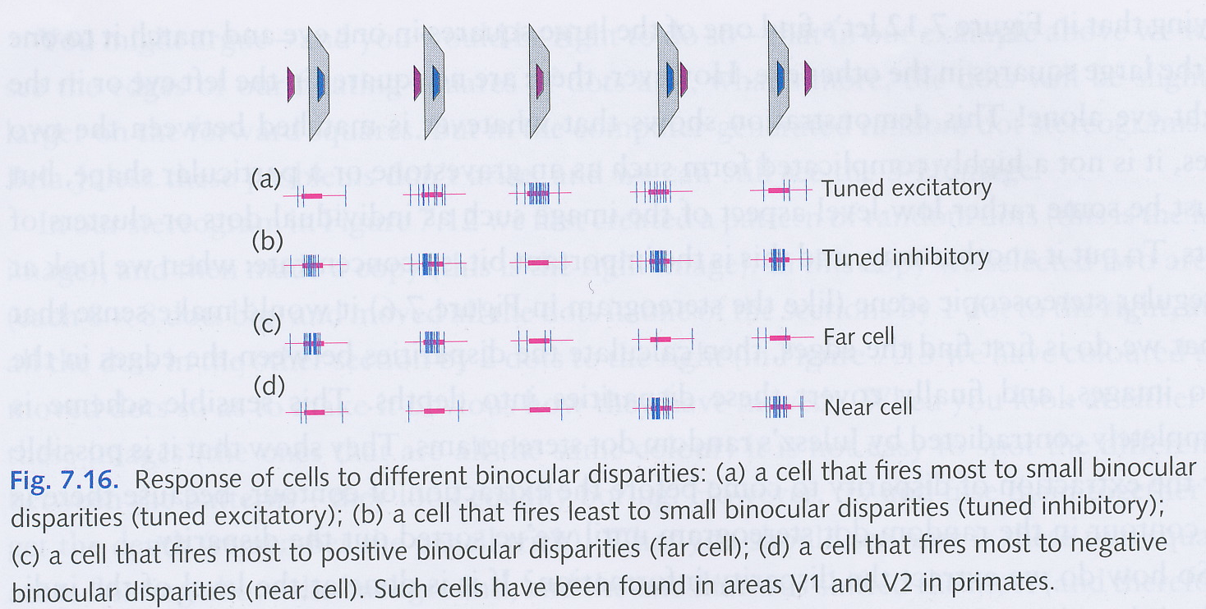
Physiological mechanisms and disparity
First place where there are binocular cells is V1 so this is the earliest centre in the visual pathway where disparity can be used to compute depth
Four types of cell in V1/V2 that respond to binocular disparity (see figure above)

Slide 23
Stereo blindness
About 5% of the population are stereo-blind and cannot see figures in stereograms
This can happen if you had visual problems in early childhood (e.g., lazy eye or strabismus)
Eyes need to be properly aligned in order to see stereograms
If you are stereo-blind, you can still see depth – there must therefore be other ways that the brain gets depth-information from a scene

Slide 24
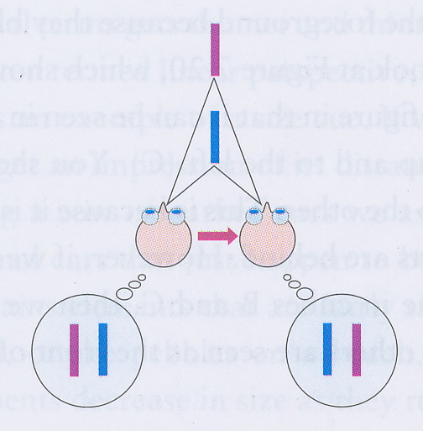
Motion parallax
If the head or eyes move, then nearer objects move faster on the retina than objects further away
On the motorway, the lamp-posts move by quickly, but the distant hills move slowly
If viewer is moving, then can compute distance of objects by difference in speed of retinal motion
This is motion parallax

Slide 25
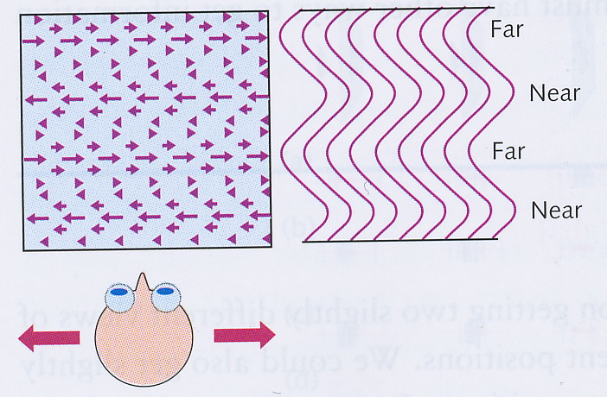
Inducing depth with moving dots
Rogers and Graham (1979) made a pattern of random dots on a screen
When stationary, dots look to be on a flat surface
When observer moves, dots made to move too in the same way as they would if they were on a corrugated surface
Viewer now sees the dots as being stationary on a corrugated surface, not as dots moving in different directions on a flat surface
Motion parallax used by cats and golfers to better judge distances

Slide 26
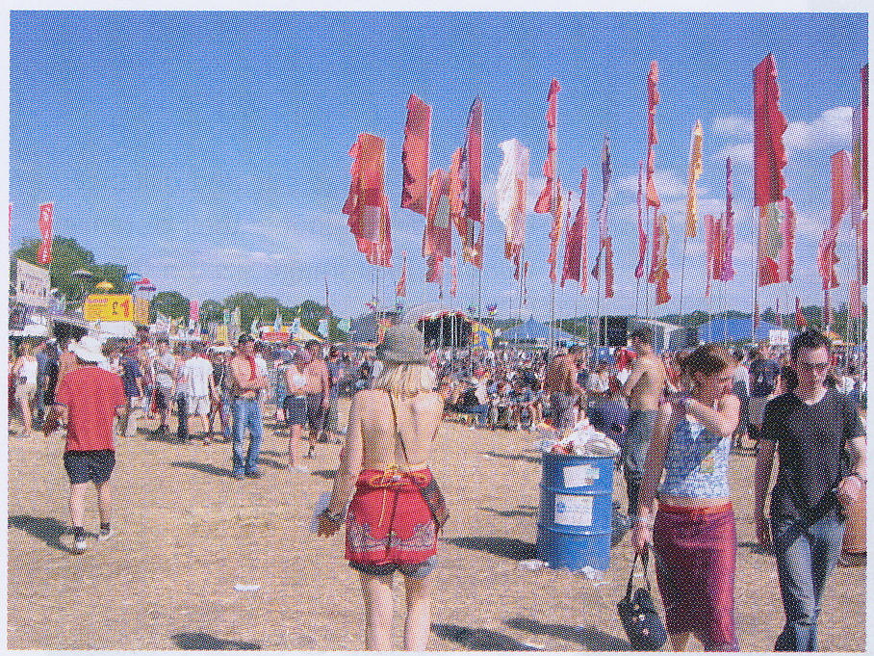
Pictorial cues
We can judge distances in 2-D photographs where we cannot use stereopsis and we cannot use motion parallax
Various pictorial cues used in this situation
Occlusion or interposition
Size cues
Shading and shadows
Aerial perspective

Slide 27
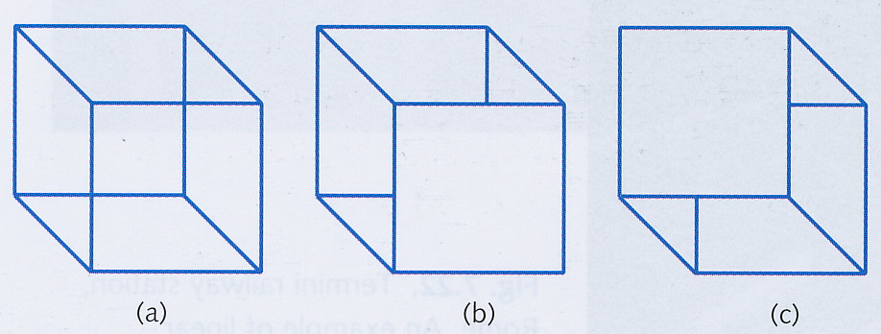
Occlusion or interposition
If an object is in front of another then it occludes the one behind it
Brain uses information about occlusion to help determine relative depth of objects
Necker cube is ambiguous because there is no occlusion – the cube is transparent!
Can be interpreted in two ways – multistable percept
If make one face opaque, then disambiguates the figure
Note that brain tries to interpret it as 3-D figure even when it is ambiguous!

Slide 28
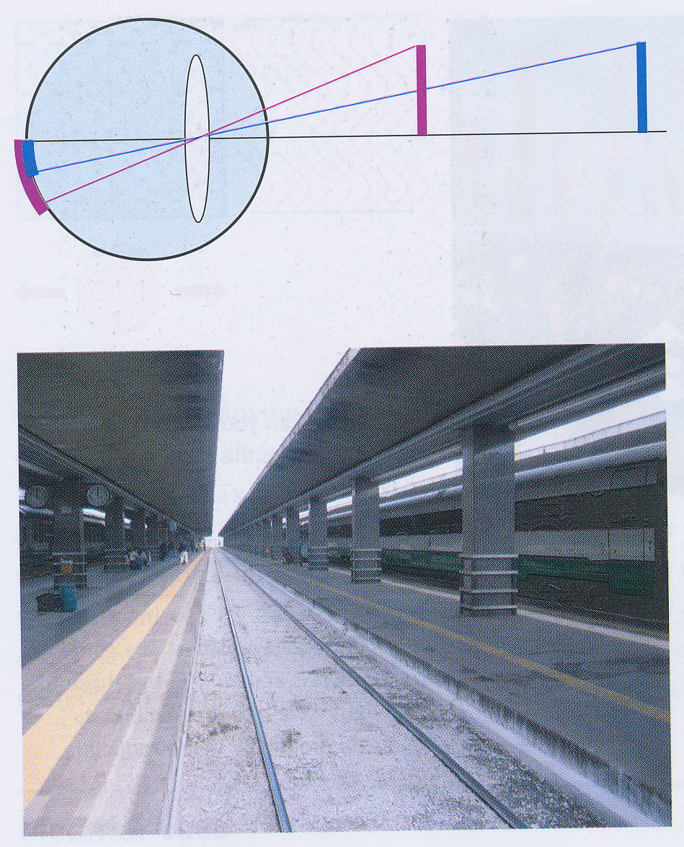
Size cues
As an object moves away, its retinal image gets proportionally smaller
This is linear perspective
Get a vivid sense of depth when viewing a receding road or railway track
If we know real size of something, then can judge distance from retinal size

Slide 29
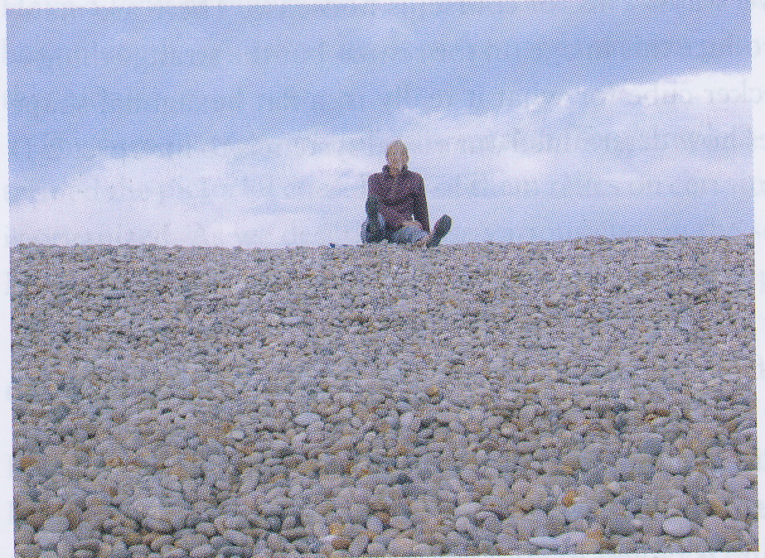
Texture gradients
If scene contains many similar elements, then can get a good sense of distance e.g.,
pebbles on a beach
row of cars
field of corn
This is texture perspective or texture gradients

Slide 30
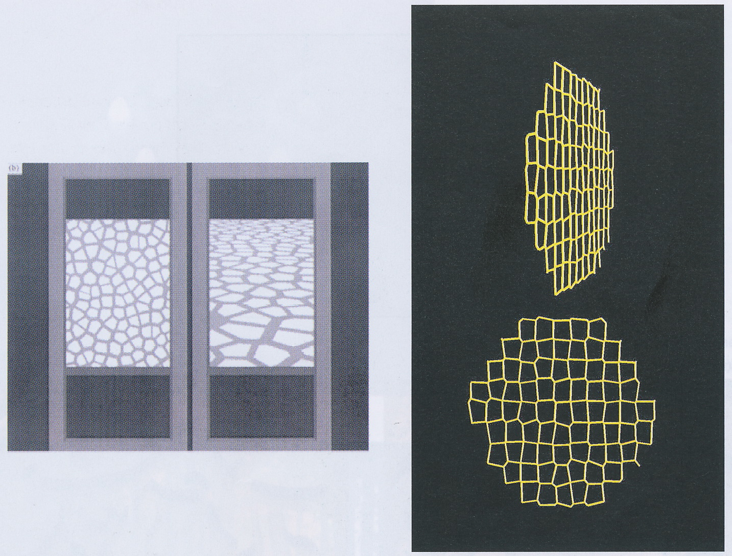
Voronoi patterns
Can even get good sense of perspective from a pattern of similar elements when we don’t know the real size of the elements
This is the basis of a Voronoi pattern

Slide 31
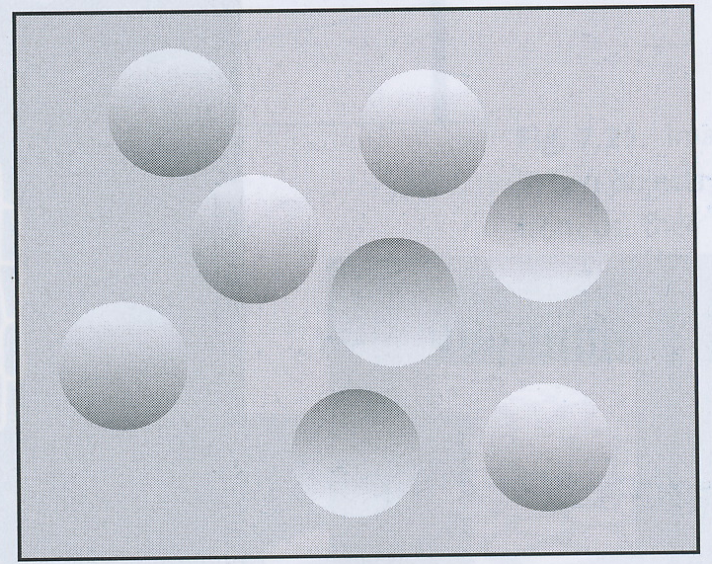
Shading and shadows
Brain assumes light comes from above
Can then use shading shadows to infer depth information
Whether we see a disk on the left as being convex or concave is determined by the assumption that light comes from the top
If the image is side-on, then it is ambiguous

Slide 32
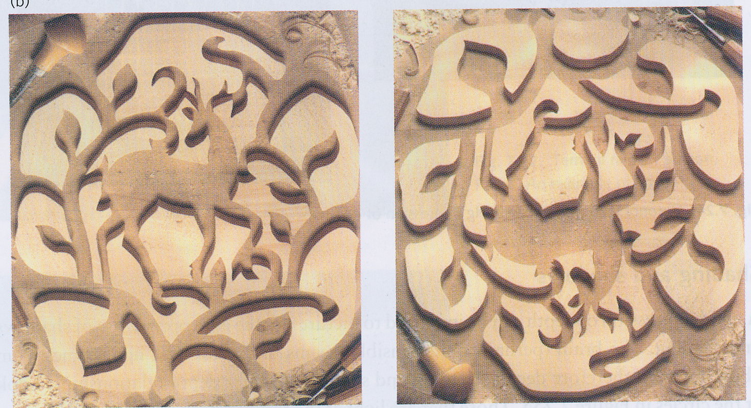
Shading and shadows
Another example of using shadows to infer depth

Slide 33
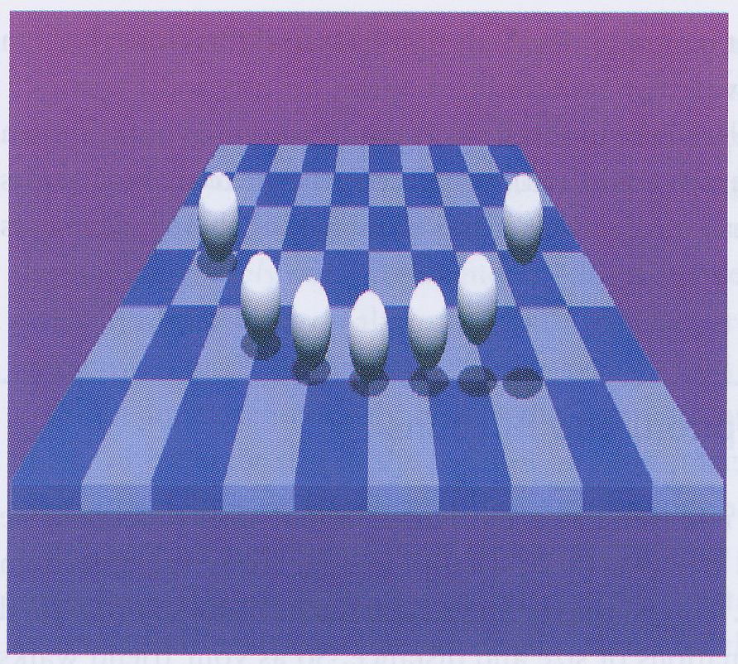
Shadows
Placement of shadows is also used as a pictorial cue to depth

Slide 34
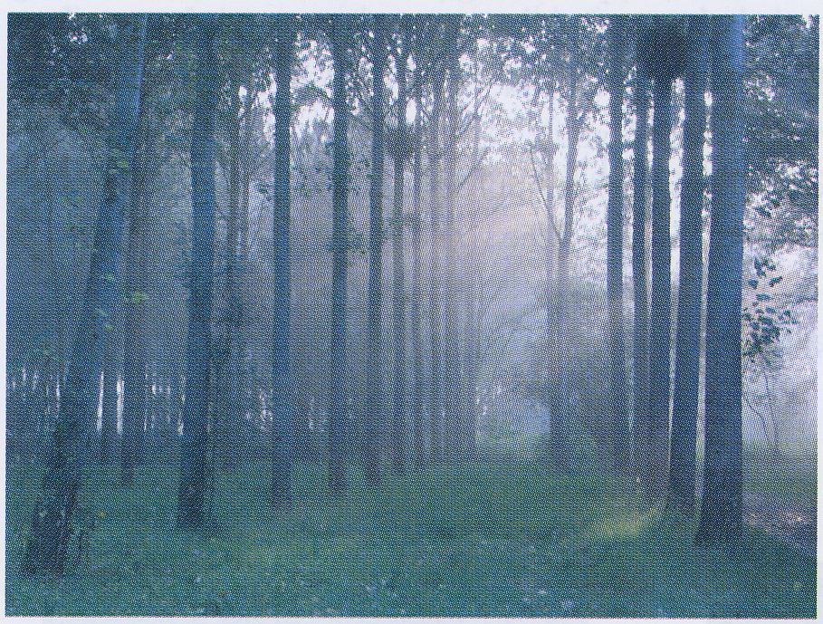
Aerial perspective
Light gets scattered as it travels through the air
Further away an object is, the more the light from it is scattered and the more hazy it appears
Usually only works over large distances
But in mist and fog, it can operate for near objects
Makes things appear further away than they are
Can cause accidents when driving in fog
If particularly clean or dry air (e.g., mountain top, desert, moon) then objects can appear nearer than they really are (e.g., oasis)
Visual system “trained” in normal situations, so sometimes misinterprets unusual situations

Slide 35
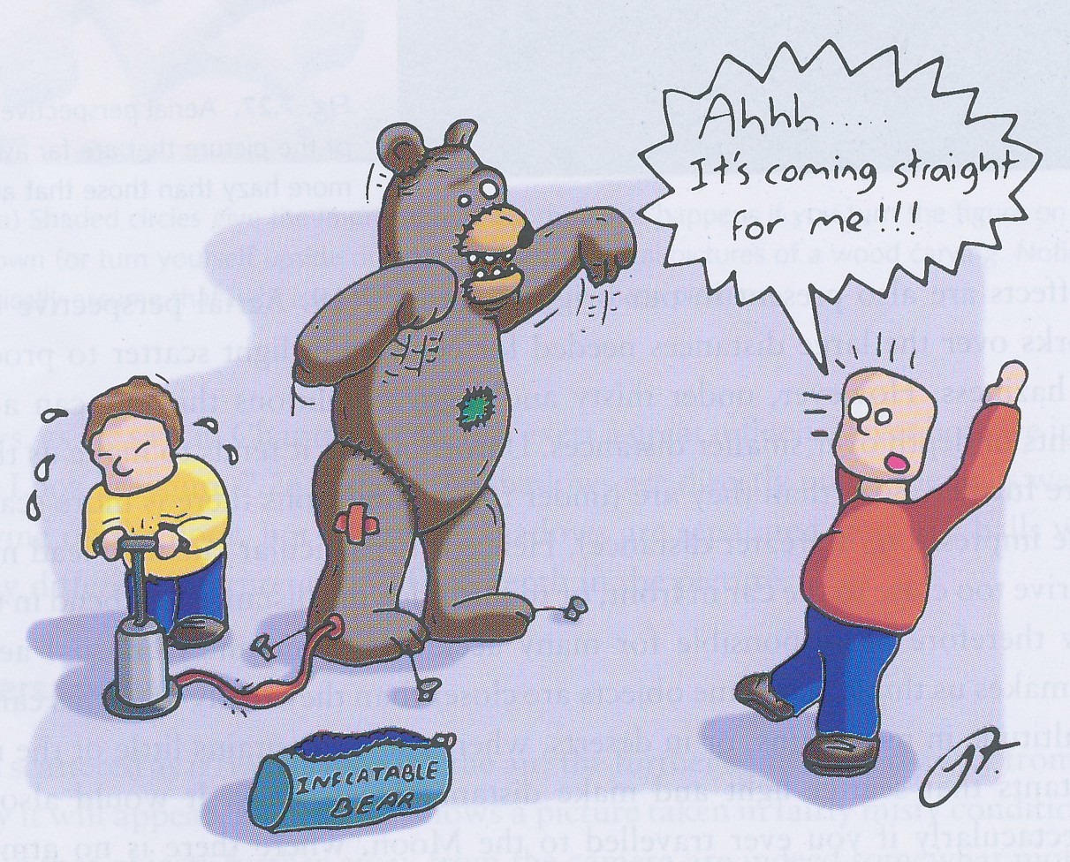
Size constancy
If your friend walks towards you, how do you know that she’s coming towards you and not swelling up like a balloon?
The retinal image of a small tree close up can be the same as a large tree far away
Our brain assumes that objects stay the same size unless there’s strong evidence to the contrary

Slide 36
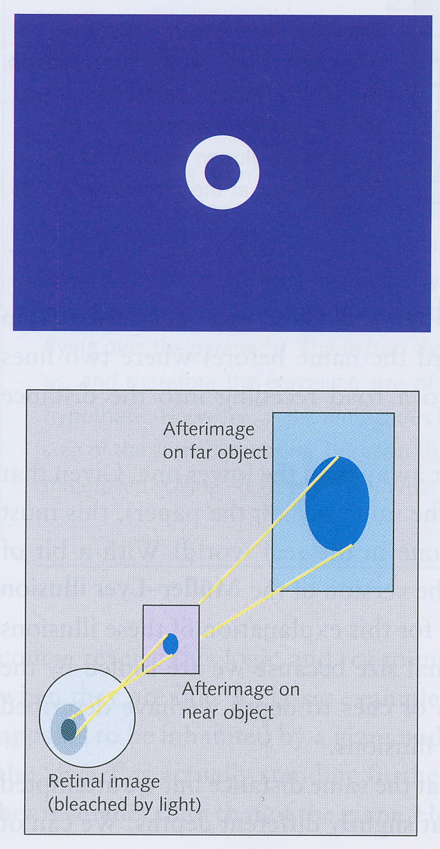
Emmert’s Law
Emmert’s Law: For a given retinal image size, perceived size is proportional to perceived distance
Can demonstrate this with a bright-light after-image
use a camera flash or the figure on the left – NOT THE SUN
Isaac Newton reported black disk-shaped after-images months after looking at the Sun – had probably burnt a hole in his retina!
If you look at a close object, after-image appears small; if you look at a distant object, after-image appears large
But retinal size of after-image is constant

Slide 37
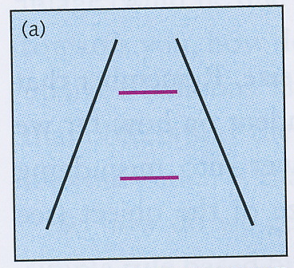
Illusions based on Emmert’s Law
Perceived size of a thing depends on its perceived distance from the viewer
So if can fool viewer about distance, then can also fool viewer about size
Ponzo illusion
Simulate linear perspective using two converging lines
Same-sized horizontal lines between converging lines appear to be of different sizes

Slide 38
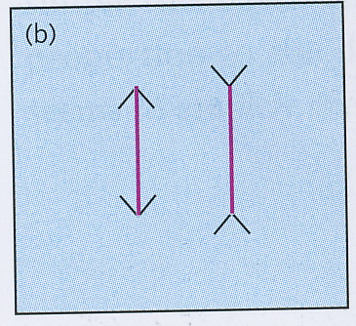
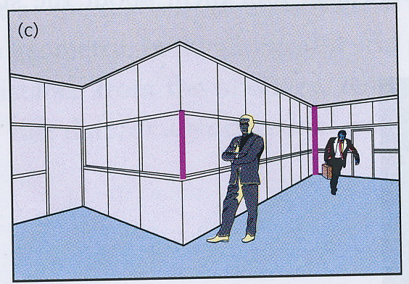
Müller-Lyer illusion
Perceive two same-sized vertical lines to be at different distances and therefore of different lengths
Principle of these illusions is misapplied constancy scaling

Slide 39
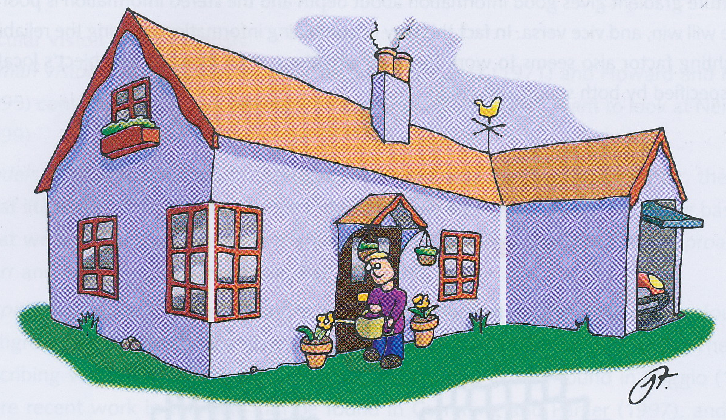
Müller-Lyer illusion

Slide 40
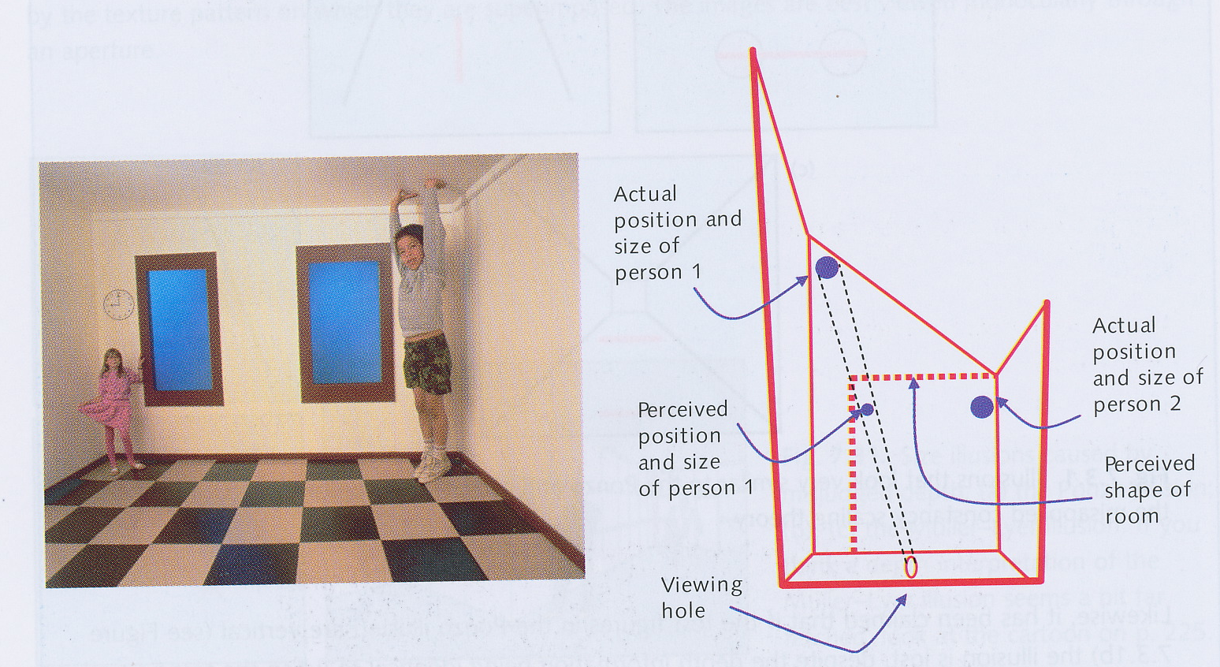
Ames room
The converse of the previous illusions is to make you think that two things are of different sizes by making them seem to be at the same distance

Slide 41
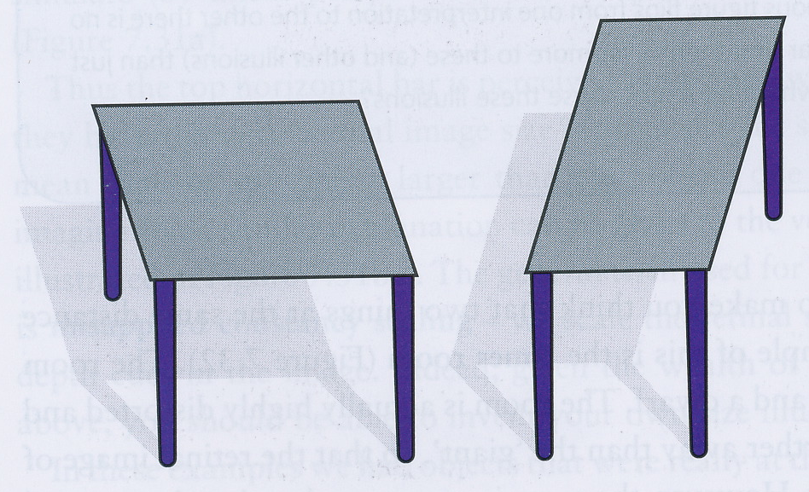
Table-top illusion
Two parallelograms have same-sized retinal image but made to look like they’re of different shape by adding legs, which cues us to interpret them as being in 3-D
The visual system automatically attempts to interprets scenes as though they are in 3 dimensions

